Slide 1
Capstone Design
Team 3
20163704
20161344
20164245
Park JuHyeon
Heo JeongWoo
Hong Jin

Slide 2
Contents
1.
Feedback
Progress
Schedule
Q&A
2.
3.
4.

Slide 3



♥
Project Introduction
Smoothie
person
Input
Output

Slide 4
1.
Q&A Feedback

Slide 5
2.
Progress

Slide 6
2.1
QT

Slide 7
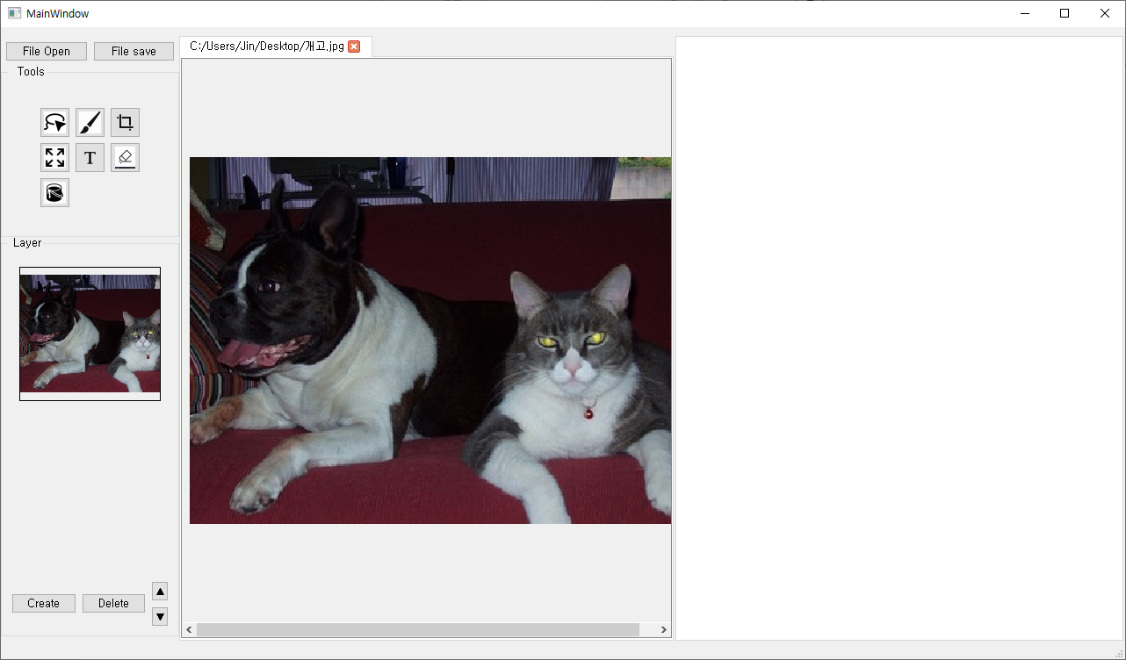
2
Progress
Zoom In & Zoom Out
Easy to Zoom -> Ctrl + Scroll

Slide 8
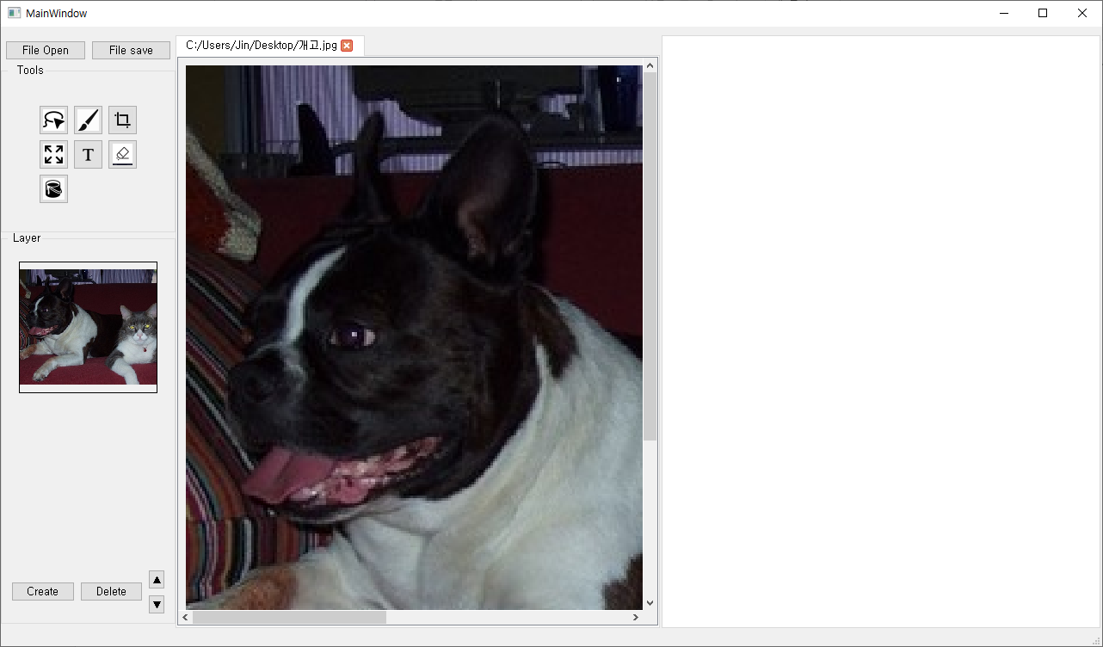
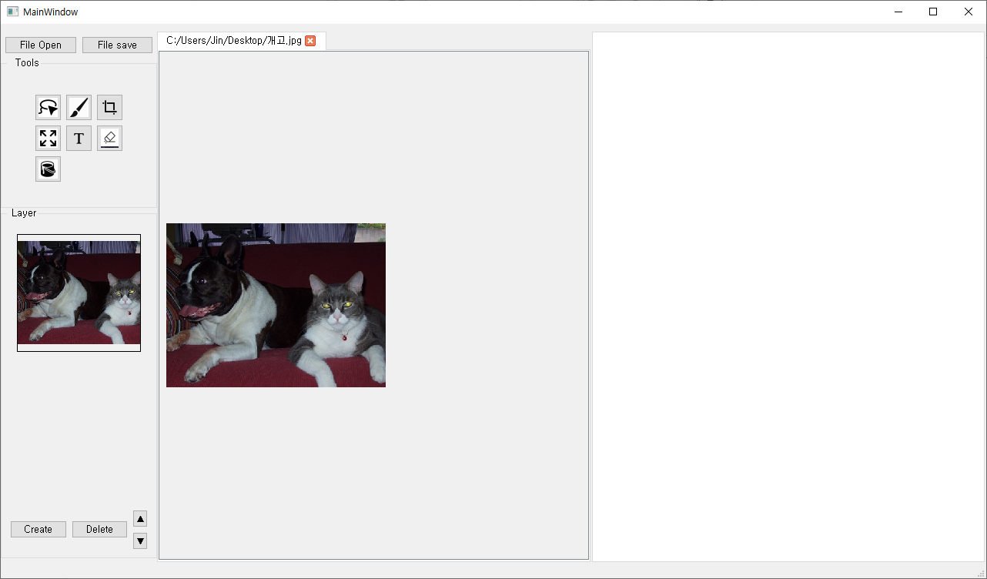
2
Progress
Zoom In & Zoom Out
Zoom In
Zoom Out

Slide 9
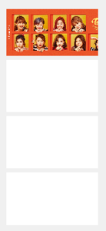
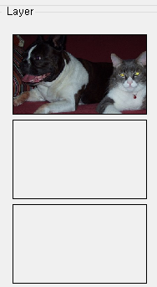
2
Progress
Layer Transparency
Changed

Slide 10

2
Progress
Drawing Functions
Drawing Functions
Brush, Paint, Eraser, Text

Slide 11
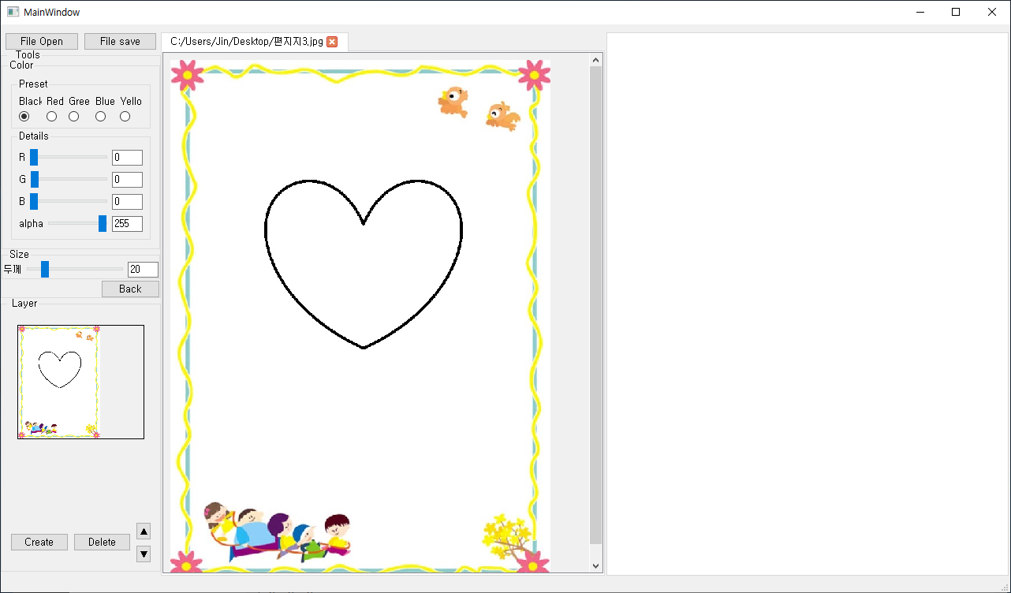
2
Progress
Drawing Functions
Use Brush, Draw Heart

Slide 12
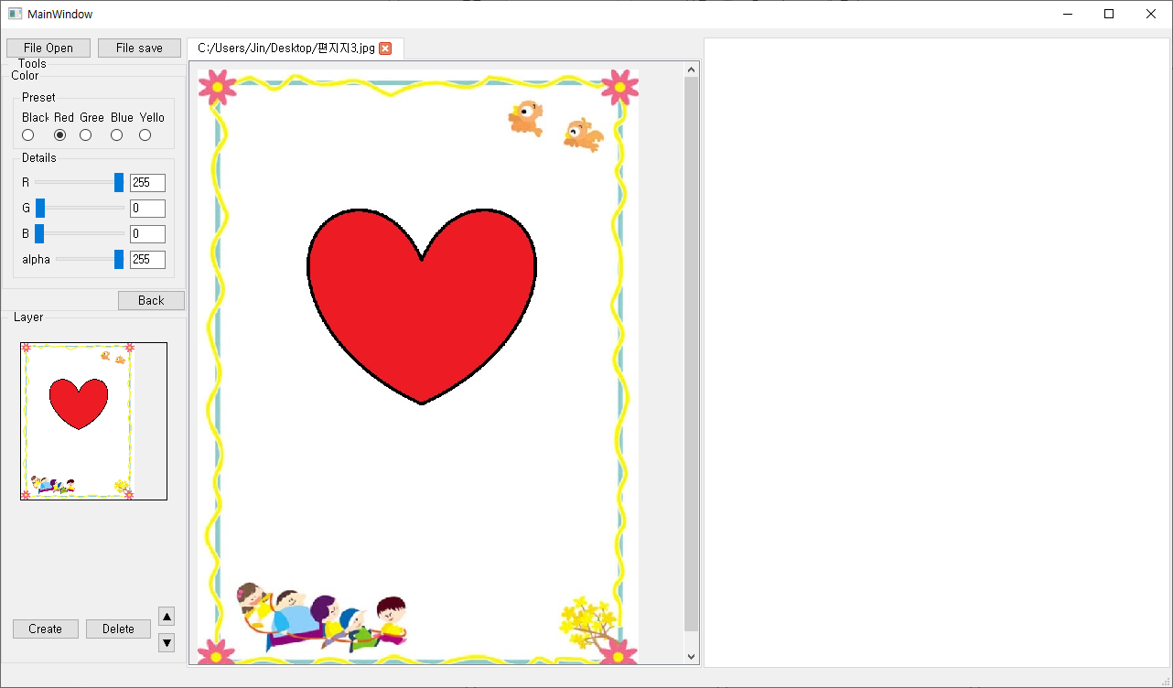
2
Progress
Drawing Functions
Use Paint, Make Red Heart

Slide 13
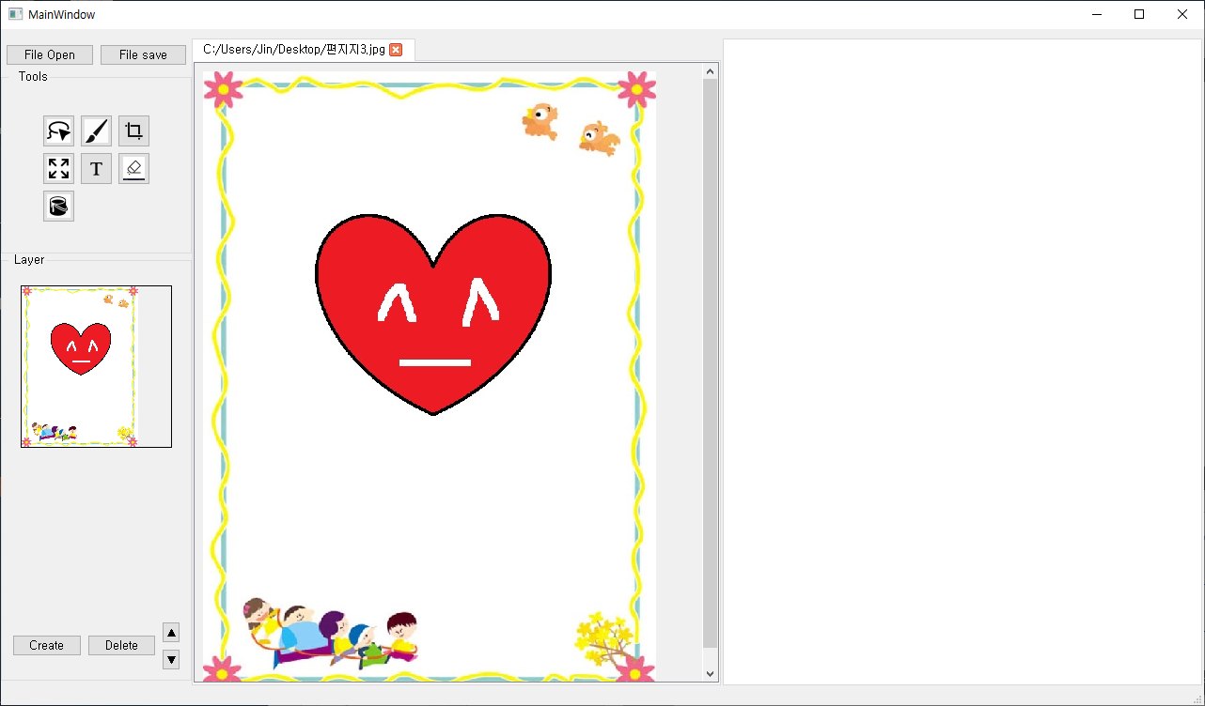
2
Progress
Drawing Functions
Use Eraser, Make Smile^_^

Slide 14
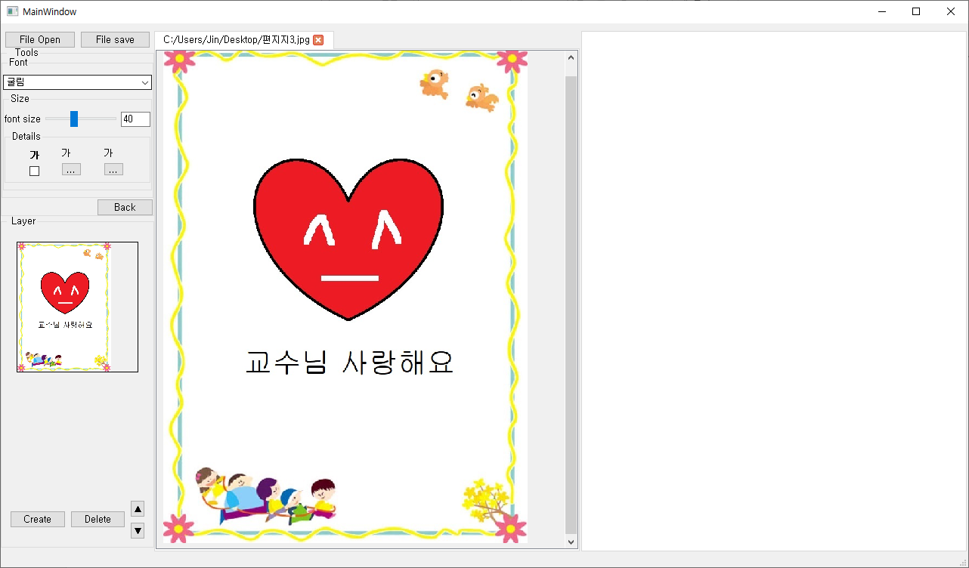
2
Progress
Drawing Functions
Use Text, Make Message

Slide 15
2.2
Test & Debugging

Slide 16
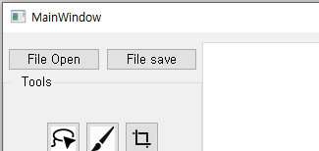
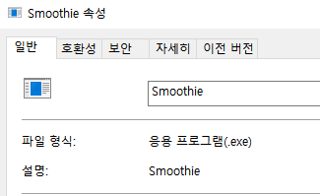
2
Progress
Test & Debugging – Together
IMPORTANT
We forget Change Logo
MainWindow`s Name

Slide 17
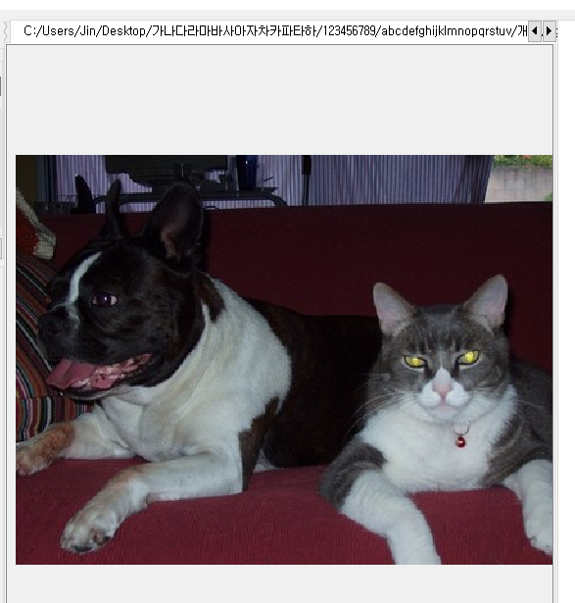
2
Progress
Test & Debugging – Together
Find Tab name Error
If name is too long and only one file exist,
Can`t press delete Button.

Slide 18
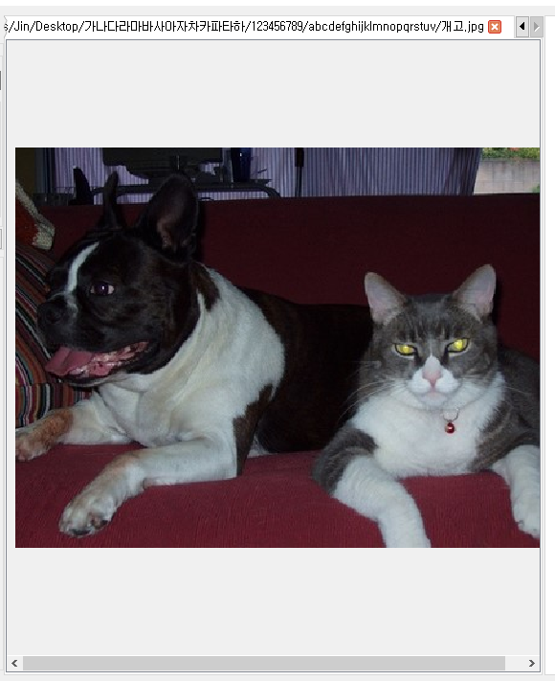
2
Progress
Test & Debugging – Together
Find Tab name Error
Now Change press > button to solve Problem

Slide 19
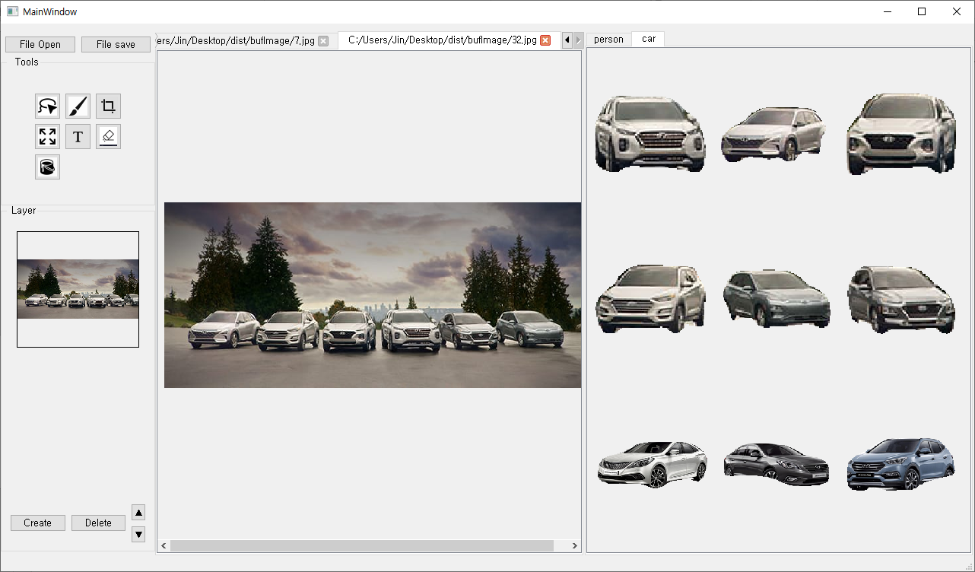
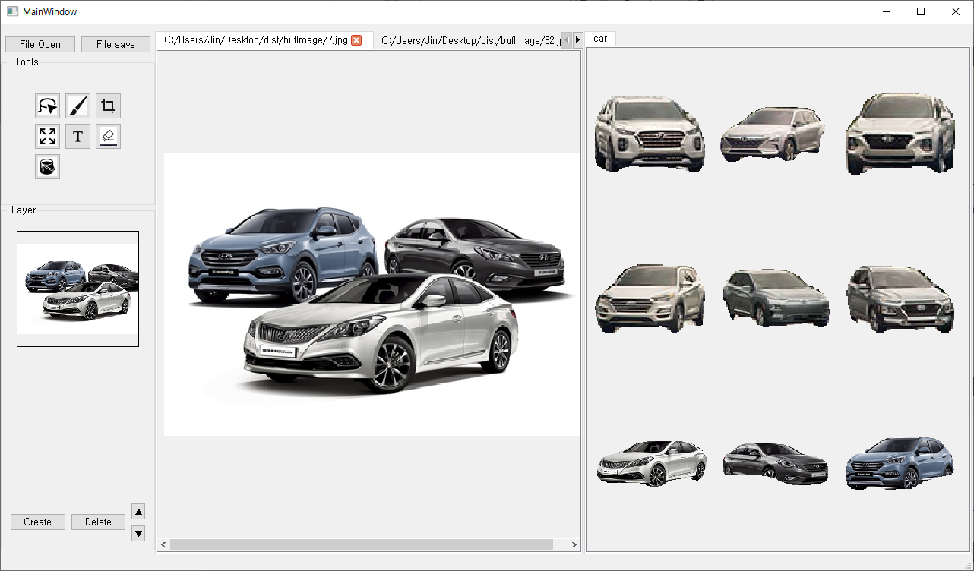
2
Progress
Test & Debugging – Together
Test Other Category Lasso function

Slide 20
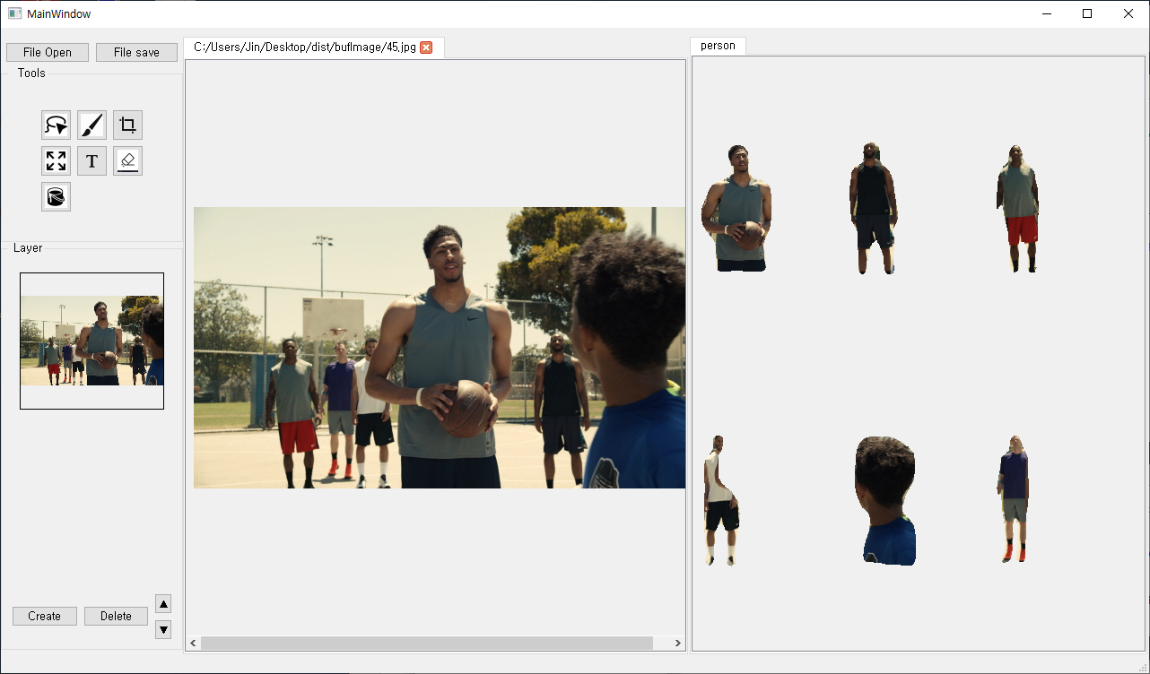
2
Progress
Test & Debugging – Together
Test More Complex image in Lasso function

Slide 21
2.3
Prepare Demo

Slide 22
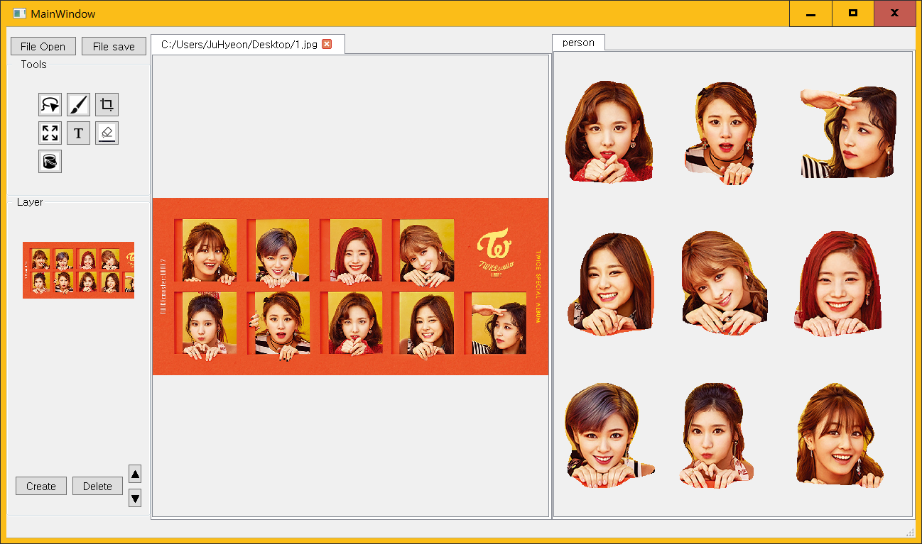
2
Progress
Prepare Demo
Demo will focus on the lasso function

Slide 23
2
Progress
Prepare Demo
We will show you how to use it as a sticker.

Slide 24
2
Progress
Prepare Demo
We will email the designer to request evaluation of our program.
EX) Are you use these programs if this program offered to you?

Slide 25

2
Progress
Prepare Demo
Designer`s feedback will be added to the development later.

Slide 26
3.
Schedule

Slide 27
3
Schedule
 | March |  |  | April |  |  |  |  | May |  |  |  | June
Week | 11 | 18 | 25 | 1 | 8 | 15 | 22 | 29 | 6 | 13 | 20 | 27 | 3 | 10 | 17
Data survey
Collect Datasets
Detection Model
Segmentation Model
Lasso Function
QT basic UI
Prepare Midterm Demo
Function & QT Details
Test and Debugging
Prepare Final Demo
Writing manuals, report
Midterm Presentation
Midterm Exam
Final Presentation

Slide 28
3
Schedule
Progress | Park Juhyeon | Hong Jin | Heo Jung Woo
This Week Proceeding | Test & Debugging
 | Prepare Demo | QT Details | QT Details

Slide 29
4.
Q&A

